Slide 1
Impact Fee Work Session:
LUA and Project Plans
July 15th, 2024
Brandon Forsythe, PE
Holly Deters, PE

Slide 2
Outline
Josephine Land Use Assumptions
Josephine Impact Fee Project Plans

Slide 3
Outline
Josephine Land Use Assumptions
Josephine Impact Fee Project Plans

Slide 4
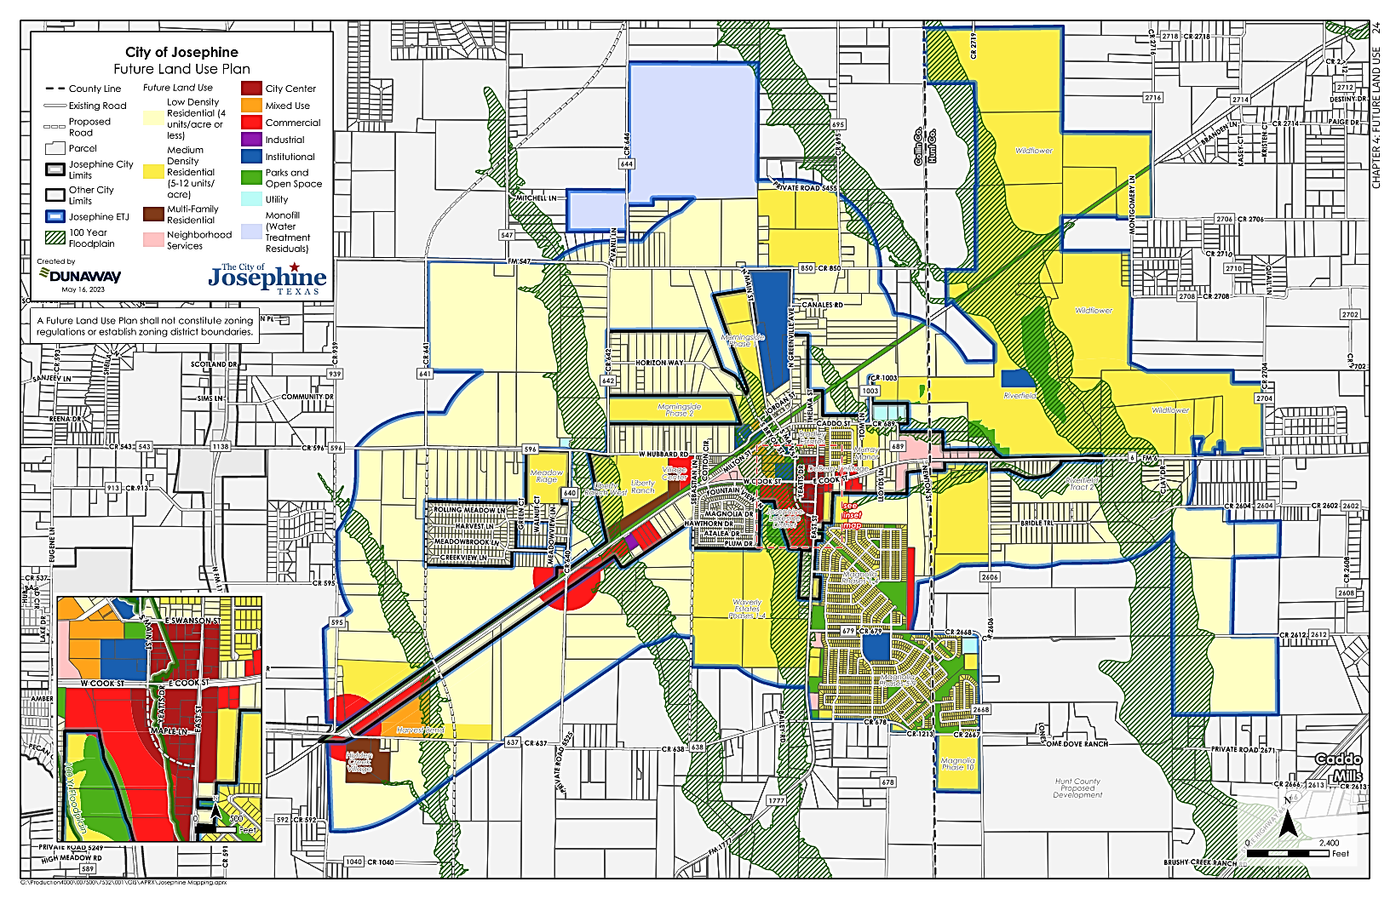
Land Use Assumptions
Coordinate with the Future Land Use Plan
  Josephine 2023 Comprehensive Plan
Establish infrastructure demands used in Master Plans
  Josephine Master Plans (March 2024)

Slide 5
Josephine LUA
Water and Wastewater Growth Projections
Roadway Growth Projections
City Limits | Residential Units |  | Non-Residential Square Feet
 | Single- Family | Multi-Family | Basic | Service | Retail
Growth | 1,477 | 1,004 | 182,000 | 865,000 | 1,072,000
ETJ | Residential Connections | Non-Residential Acres
Water Growth | 8,502 | 109
Wastewater Growth | 9,644 | 109
Notes:
Start with comp planUpdate to growth only

Slide 6
Outline
Josephine Land Use Assumptions
Josephine Impact Fee Project Plans

Slide 7
Roadway Impact Fee
Project Plan

Slide 8
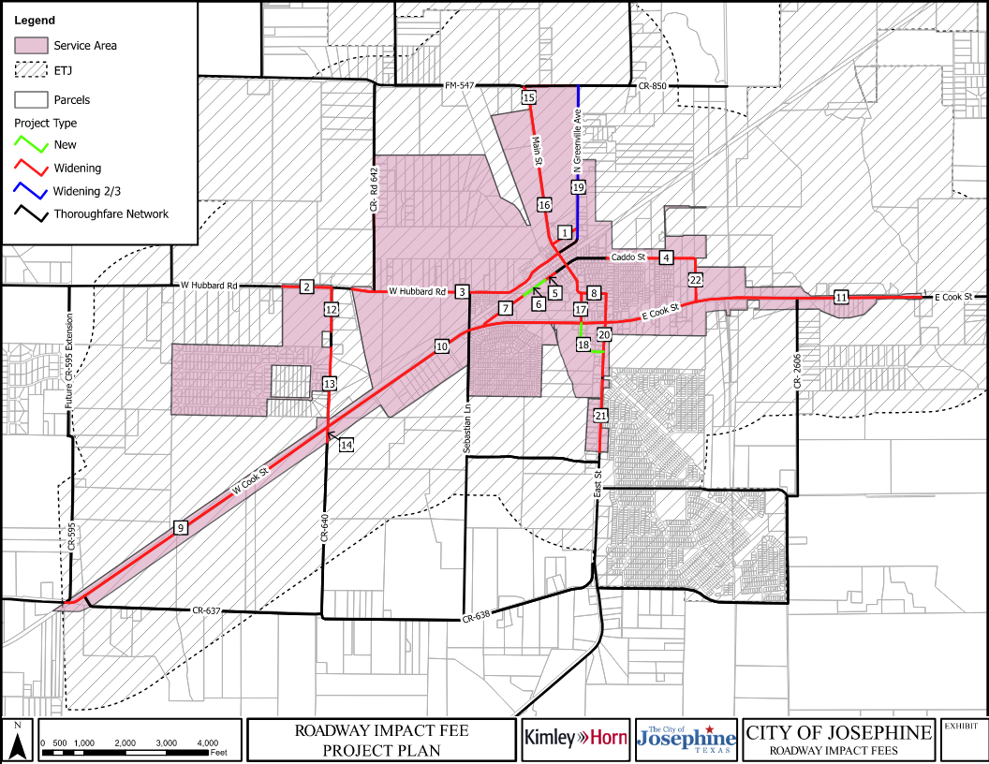

Slide 9
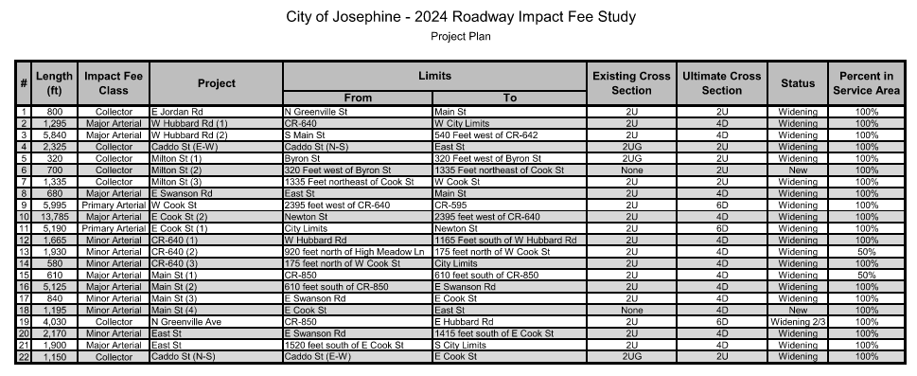

Slide 10
Water Impact Fee
Project Plan

Slide 11
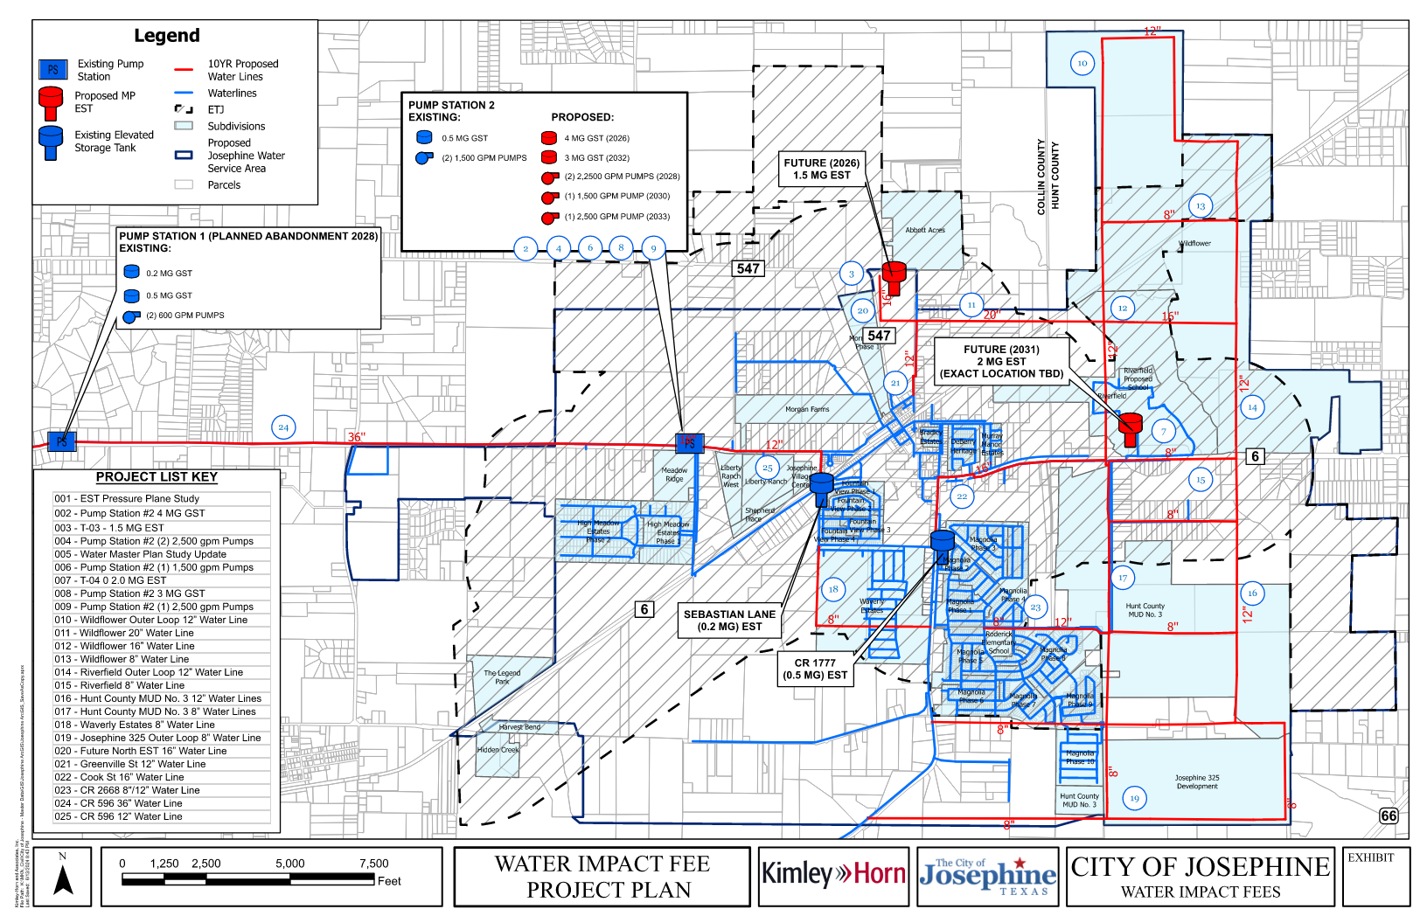

Slide 12
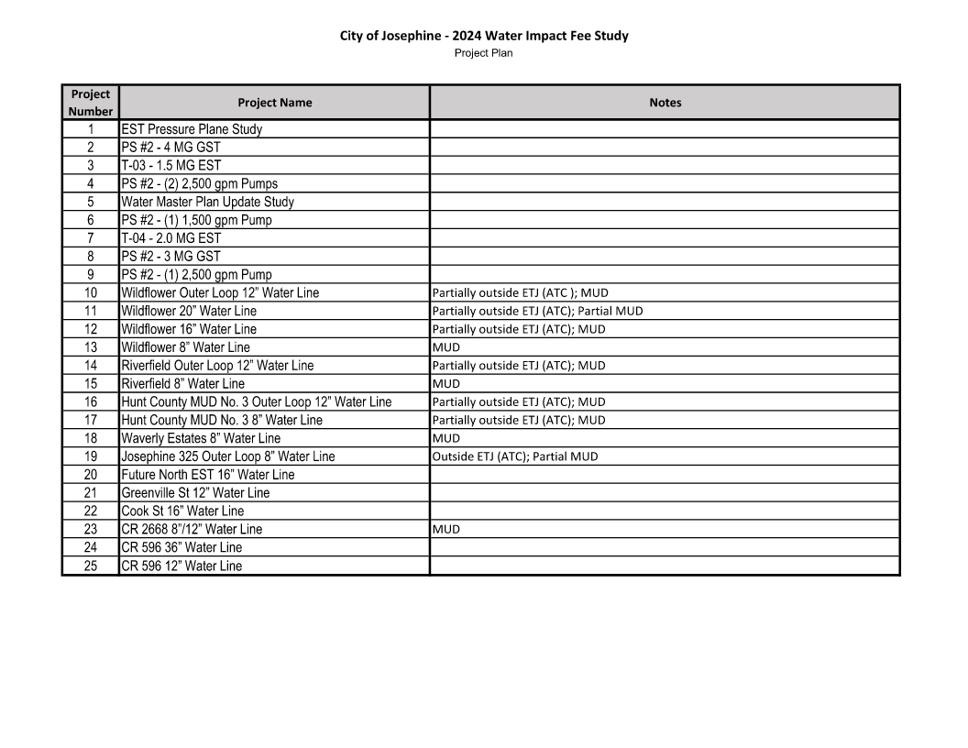

Slide 13
Wastewater Impact Fee Project Plan

Slide 14
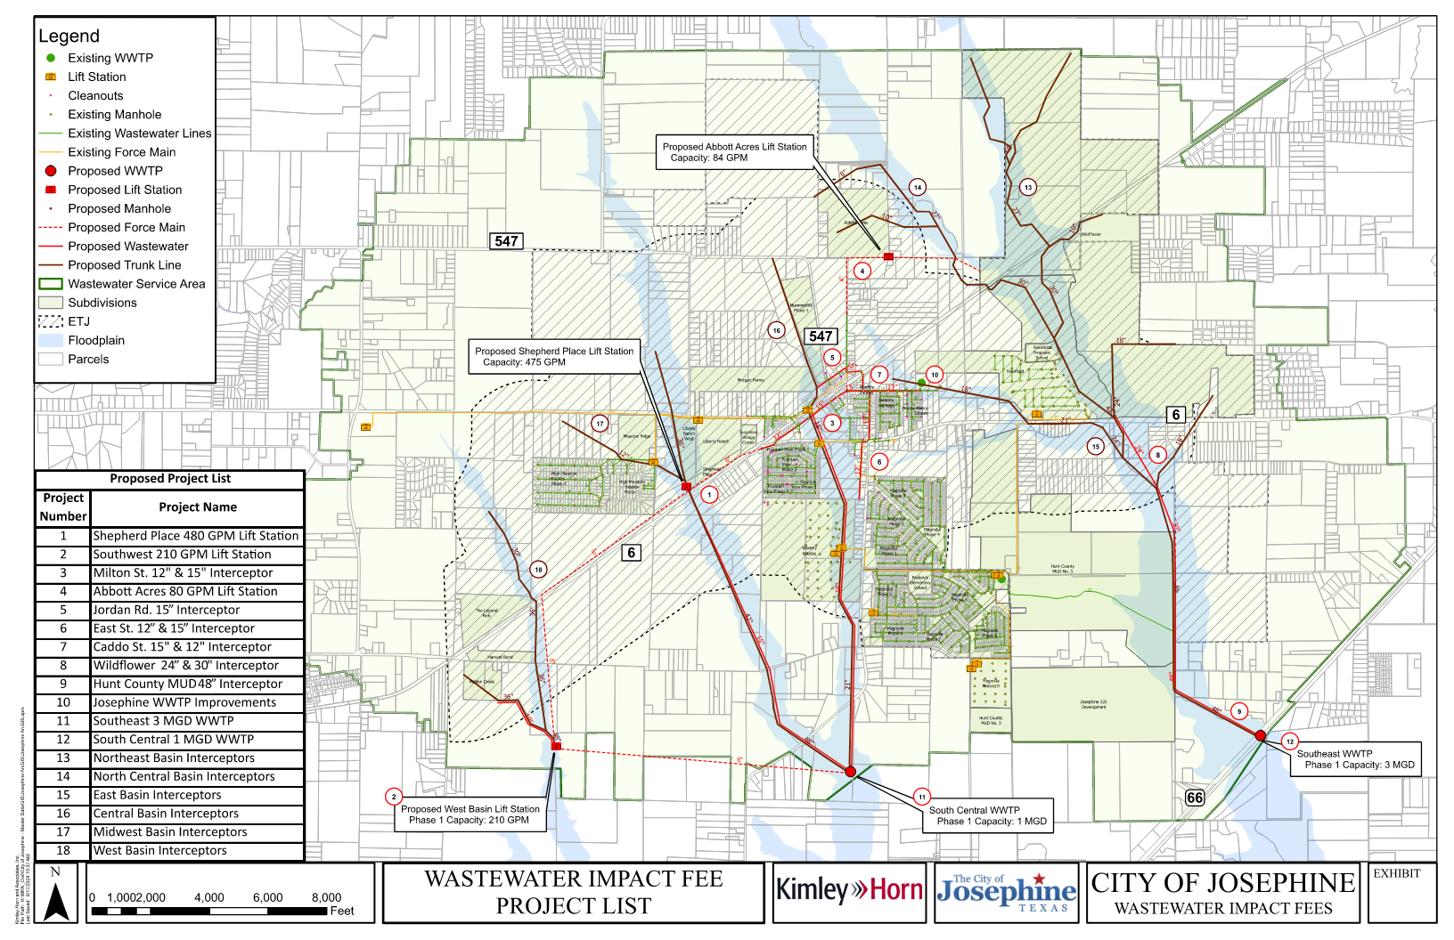

Slide 15
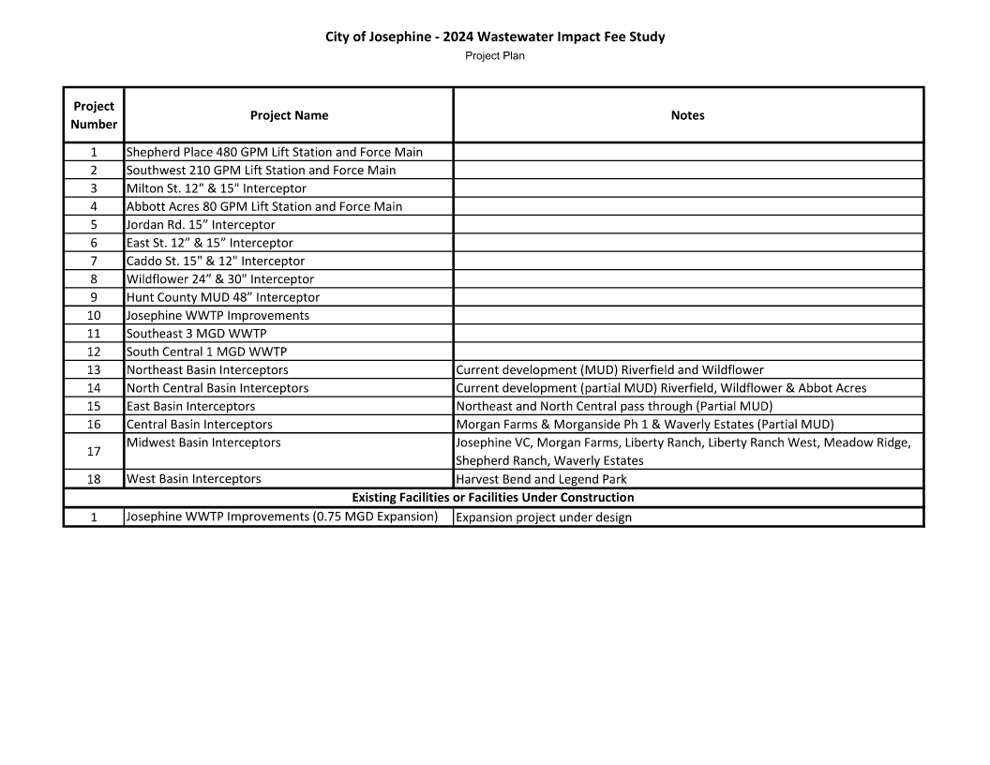

Slide 16
Next Steps
  Publish notice of Public Hearing on LUA and CIP (30 days before Public Hearing)
  CIAC file written comments on Proposed LUA and CIP by August 2nd
  Public Hearing on LUA and CIP
  Develop Max Fee based on LUA and CIP
  Present proposed Impact Fees to CIAC at August CIAC meeting

Slide 17

Questions?
Brandon Forsythe
  Brandon.Forsythe@kimley-horn.com
Holly Deters
  Holly.Deters@kimley-horn.com

